Slide 1
ECEG-5193: Algorithm Analysis and Design
Analysis of Sorting and Searching algorithms
Analysis of Merge-Sort

Slide 2
Sorting
Insertion sort
Design approach:
Sorts in place:
Best case:
Worst case:
Bubble Sort
Design approach:
Sorts in place:
Running time:
incremental
Yes
Θ(n)
Θ(n²)
incremental
Yes
Θ(n²)

Slide 3
Sorting
Selection sort
Design approach:
Sorts in place:
Running time:
Merge Sort
Design approach:
Sorts in place:
Running time:
incremental
Yes
Θ(n²)
divide and conquer
No
Let’s see!!

Slide 4
Divide-and-Conquer
Divide the problem into a number of sub-problems
Similar sub-problems of smaller size
Conquer the sub-problems
Solve the sub-problems recursively
Sub-problem size small enough ⇒ solve the problems in straightforward manner
Combine the solutions of the sub-problems
Obtain the solution for the original problem

Slide 5
Merge Sort Approach
To sort an array A[p . . r]:
Divide
Divide the n-element sequence to be sorted into two subsequences of n/2 elements each
Conquer
Sort the subsequences recursively using merge sort
When the size of the sequences is 1 there is nothing more to do
Combine
Merge the two sorted subsequences

Slide 6
Merge Sort
p
q
r
1
2
3
4
5
6
7
8
5
2
4
7
1
3
2
6
MERGE-SORT(A, p, r)
if p < r
then q ← ⎣(p + r)/2⎦
MERGE-SORT(A, p, q)
MERGE-SORT(A, q + 1, r)
MERGE(A, p, q, r)
Initial call: MERGE-SORT(A, 1, n)
Check for base case
Divide
Conquer
Conquer
Combine

Slide 7
Example – n Power of 2
1
2
3
4
5
6
7
8
5
2
4
7
1
3
2
6
q = 4
1
2
3
4
5
6
7
8
5
2
4
7
1
3
2
6
1
2
3
4
5
6
7
8
5
2
4
7
1
3
2
6
1
2
3
4
5
6
7
8
5
2
4
7
1
3
2
6

Slide 8
Example – n Power of 2
1
2
3
4
5
6
7
8
1
2
2
3
4
5
6
7
1
2
3
4
5
6
7
8
2
4
5
7
1
2
3
6
1
2
3
4
5
6
7
8
2
5
4
7
1
3
2
6
1
2
3
4
5
6
7
8
5
2
4
7
1
3
2
6

Slide 9
Example – n Not a Power of 2
1
2
3
4
5
6
7
8
9
10
11
4
7
2
6
1
4
7
3
5
2
6
q = 6
1
2
3
4
5
6
7
8
9
10
11
q = 3
4
7
2
6
1
4
7
3
5
2
6
q = 9
1
2
3
4
5
6
7
8
9
10
11
4
7
2
6
1
4
7
3
5
2
6
1
2
3
4
5
6
7
8
9
10
11
4
7
2
6
1
4
7
3
5
2
6
1
2
4
5
7
8
4
7
6
1
7
3

Slide 10
Example – n Not a Power of 2
1
2
3
4
5
6
7
8
9
10
11
1
2
2
3
4
4
5
6
6
7
7
1
2
3
4
5
6
7
8
9
10
11
1
2
4
4
6
7
2
3
5
6
7
1
2
3
4
5
6
7
8
9
10
11
2
4
7
1
4
6
3
5
7
2
6
1
2
3
4
5
6
7
8
9
10
11
4
7
2
1
6
4
3
7
5
2
6
1
2
4
5
7
8
4
7
6
1
7
3

Slide 11
Merge - Pseudocode
MERGE(A, p, q, r)
Compute n₁ and n₂
Copy the first n₁ elements into L[1 . . n₁ + 1] the next n₂ elements into R[1 . . n₂ + 1]
L[n₁ + 1] ← ∞; R[n₂ + 1] ← ∞
i ← 1; j ← 1
for k ← p to r
do if L[ i ] ≤ R[ j ]
then A[k] ← L[ i ]
i ←i + 1
else A[k] ← R[ j ]
j ← j + 1
p
q
r
1
2
3
4
5
6
7
8
2
4
5
7
1
2
3
6
n₁
n₂
p
q
L
2
4
5
7
∞
q + 1
r
R
1
2
3
6
∞

Slide 12
Merge Sort – Partition Process
35 | 62 | 33 | 20 | 5 | 72 | 48 | 50
35 | 62 | 33 | 20
5 | 72 | 48 | 50
35 | 62
33 | 20
5 | 72
48 | 50
35
62
33
20
5
72
48
50

Slide 13
Merge Sort – Merge Process
?
35
62
33
20
5
72
48
50
35 | 62
20 | 33
5 | 72
48 | 50
20 | 33 | 35 | 62
5 | 48 | 50 | 72
5 | 20 | 33 | 35 | 48 | 50 | 62 | 72
35
62
33
20
5
72
48
50

Slide 14
Merging
Merge.
Keep track of smallest element in each sorted half.
Insert smallest of two elements into auxiliary array.
Repeat until done.
smallest
smallest
A
G
L
O
R
H
I
M
S
T
A
auxiliary array

Slide 15
Merging
Merge.
Keep track of smallest element in each sorted half.
Insert smallest of two elements into auxiliary array.
Repeat until done.
smallest
smallest
A
G
L
O
R
H
I
M
S
T
A
G
auxiliary array

Slide 16
Merging
Merge.
Keep track of smallest element in each sorted half.
Insert smallest of two elements into auxiliary array.
Repeat until done.
smallest
smallest
A
G
L
O
R
H
I
M
S
T
A
G
H
auxiliary array

Slide 17
Merging
Merge.
Keep track of smallest element in each sorted half.
Insert smallest of two elements into auxiliary array.
Repeat until done.
smallest
smallest
A
G
L
O
R
H
I
M
S
T
A
G
H
I
auxiliary array

Slide 18
Merging
Merge.
Keep track of smallest element in each sorted half.
Insert smallest of two elements into auxiliary array.
Repeat until done.
smallest
smallest
A
G
L
O
R
H
I
M
S
T
A
G
H
I
L
auxiliary array

Slide 19
Merging
Merge.
Keep track of smallest element in each sorted half.
Insert smallest of two elements into auxiliary array.
Repeat until done.
smallest
smallest
A
G
L
O
R
H
I
M
S
T
A
G
H
I
L
M
auxiliary array

Slide 20
Merging
Merge.
Keep track of smallest element in each sorted half.
Insert smallest of two elements into auxiliary array.
Repeat until done.
smallest
smallest
A
G
L
O
R
H
I
M
S
T
A
G
H
I
L
M
O
auxiliary array

Slide 21
Merging
Merge.
Keep track of smallest element in each sorted half.
Insert smallest of two elements into auxiliary array.
Repeat until done.
smallest
smallest
A
G
L
O
R
H
I
M
S
T
A
G
H
I
L
M
O
R
auxiliary array

Slide 22
Merging
Merge.
Keep track of smallest element in each sorted half.
Insert smallest of two elements into auxiliary array.
Repeat until done.
first half exhausted
smallest
A
G
L
O
R
H
I
M
S
T
A
G
H
I
L
M
O
R
S
auxiliary array

Slide 23
Merging
Merge.
Keep track of smallest element in each sorted half.
Insert smallest of two elements into auxiliary array.
Repeat until done.
first half exhausted
smallest
A
G
L
O
R
H
I
M
S
T
A
G
H
I
L
M
O
R
S
T
auxiliary array

Slide 24
Merging
Merge.
Keep track of smallest element in each sorted half.
Insert smallest of two elements into auxiliary array.
Repeat until done.
first half exhausted
second half exhausted
A
G
L
O
R
H
I
M
S
T
A
G
H
I
L
M
O
R
S
T
auxiliary array

Slide 25
Running Time of Merge (assume last for loop)
Initialization (copying into temporary arrays):
Θ(n₁ + n₂) = Θ(n)
Adding the elements to the final array:
n iterations, each taking constant time ⇒ Θ(n)
Total time for Merge:
Θ(n)

Slide 26
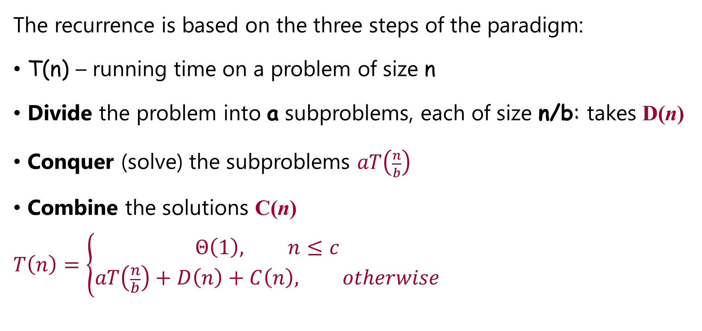
Analyzing Divide-and Conquer Algorithms
The recurrence is based on the three steps of the paradigm:
T(n) – running time on a problem of size n
Divide the problem into a subproblems, each of size n/b: takes D(n)
Conquer (solve) the subproblems $aT\left(\frac{n}{b}\right)$
Combine the solutions C(n)
$$T\left(n\right)=\left\{\begin{aligned}Θ\left(1\right), n≤c \\ &aT\left(\frac{n}{b}\right)+D\left(n\right)+C\left(n\right), otherwise\end{aligned}\right.$$

Slide 27
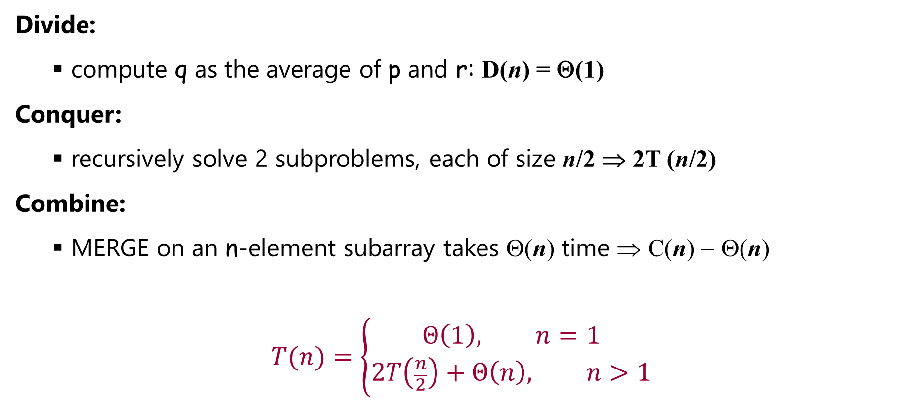

MERGE-SORT Running Time
$$T\left(n\right)=\left\{\begin{aligned}Θ\left(1\right), n≤c \\ &aT\left(\frac{n}{b}\right)+D\left(n\right)+C\left(n\right), otherwise\end{aligned}\right.$$
Divide:
compute q as the average of p and r: D(n) = Θ(1)
Conquer:
recursively solve 2 subproblems, each of size n/2 ⇒ 2T (n/2)
Combine:
MERGE on an n-element subarray takes Θ(n) time ⇒ C(n) = Θ(n)
$$T(n)=\left\{\begin{aligned}Θ\left(1\right), n=1 \\ &2T\left(\frac{n}{2}\right)+Θ\left(n\right), n>1\end{aligned}\right.$$

Slide 28
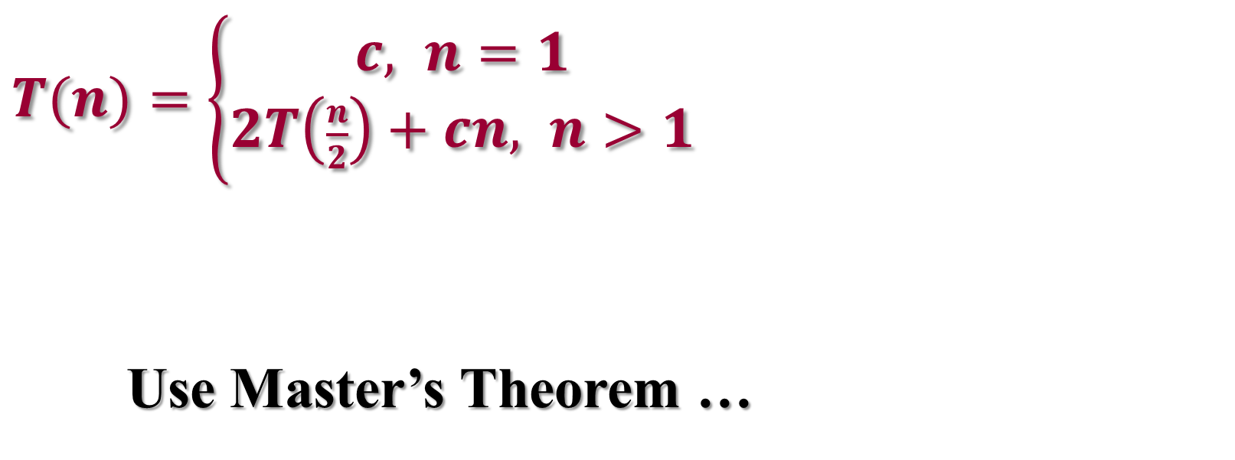
Solve the Recurrence
MergeSort Running Time
$T(n)=\left\{\begin{aligned}c, n=1 \\ &2T\left(\frac{n}{2}\right)+cn, n>1\end{aligned}\right.$
Use Master’s Theorem …

Slide 29
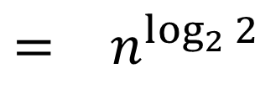
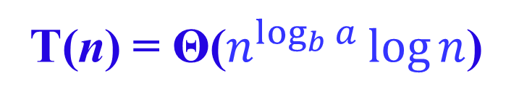
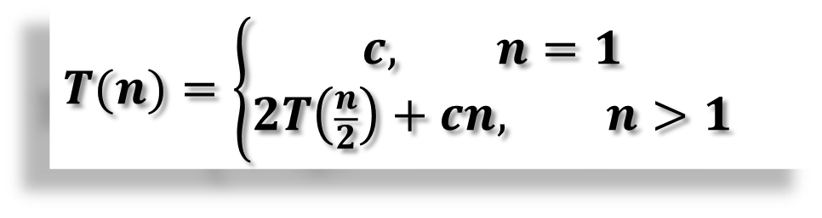
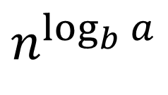

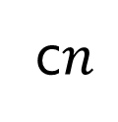

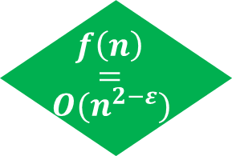
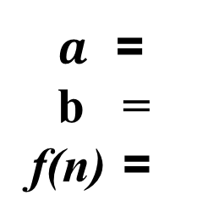
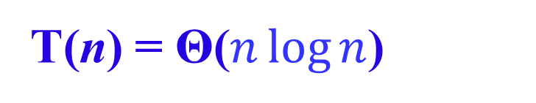
Solve the Recurrence
$$f\left(n\right)$$
$$=$$
$$O(n^{2−ε})$$
$$T(n)=\left\{\begin{aligned}c, n=1 \\ &2T\left(\frac{n}{2}\right)+cn, n>1\end{aligned}\right.$$
Case 1: if f(n) = O(n^{log}_{b}^{a -ε}) for some ε > 0, then: T(n) = Θ(n^{log}_{b}ª)
Case 2: if f(n) = Θ(n^{log}_{b}ª), then: T(n) = Θ(n^{log}_{b}ª lgn)
Case 3: if f(n) = Ω(n^{log}_{b}^{a +ε}) for some ε > 0, and if af(n/b) ≤ cf(n) for some c < 1 and all sufficiently large n, then: T(n) = Θ(f(n))
$a$ = b = f(n) =
2
$$n^{\log_{b}{a}}$$
$$\begin{matrix}= & n^{\log_{2}{2}} \\ & \end{matrix}$$
2
c$n$
$$\begin{matrix} & \\ = & n\end{matrix}$$
$$Compare n with f(n)$$
Case 2:
T(n) = Θ($n^{\log_{b}{a}}\log{n}$)
T(n) = Θ($n\log{n}$)

Slide 30
Merge Sort - Discussion
Running time insensitive of the input
Advantages:
Guaranteed to run in Θ(nlgn)
Disadvantage
Requires extra space ≈N

Slide 31
Sorting Challenge 1
Problem: Sort a file of huge records with tiny keys
Example application: Reorganize your MP-3 files
Which method to use?
merge sort, guaranteed to run in time ∼NlgN
selection sort
bubble sort
a custom algorithm for huge records/tiny keys
insertion sort

Slide 32
Sorting Files with Huge Records and Small Keys
Insertion sort or bubble sort?
NO, too many exchanges
Selection sort?
YES, it takes linear time for exchanges
Merge sort or custom method?
Probably not: selection sort simpler, does less swaps

Slide 33
Sorting Challenge 2
Problem: Sort a huge randomly-ordered file of small records
Application: Process transaction record for a phone company
Which sorting method to use?
Bubble sort
Selection sort
MergeSort guaranteed to run in time ∼NlgN
Insertion sort

Slide 34
Sorting Huge, Randomly - Ordered Files
Selection sort?
NO, always takes quadratic time
Bubble sort?
NO, quadratic time for randomly-ordered keys
Insertion sort?
NO, quadratic time for randomly-ordered keys
MergeSort?
YES, it is designed for this problem

Slide 35
Sorting Challenge 3
Problem: sort a file that is already almost in order
Applications:
Re-sort a huge database after a few changes
Doublecheck that someone else sorted a file
Which sorting method to use?
Mergesort, guaranteed to run in time ∼NlgN
Selection sort
Bubble sort
A custom algorithm for almost in-order files
Insertion sort

Slide 36
Sorting Files That are Almost in Order
Selection sort?
NO, always takes quadratic time
Bubble sort?
NO, bad for some definitions of “almost in order”
Ex: B C D E F G H I J K L M N O P Q R S T U V W X Y Z A
Insertion sort?
YES, takes linear time for most definitions of “almost in order”
MergeSort or custom method?
Probably not: insertion sort simpler and faster

